Slide 1
FANDANGO MOVIE RATING DISCREPANCY ANALYSIS USING PYTHON
CAPSTONE PROJECT
Presented By:
Salamon Vincent Raj R,
Ssm Institute Of Engineering And Technology,
Electrical And Electronic Engineering.

Slide 2
OUTLINE
Problem Statement
Proposed System/Solution
System Development Approach
Algorithm & Deployment
Result
Conclusion
Future Scope
References

Slide 3
Problem Statement
“Explore and analyze the potential rating discrepancies in Fandango movie ratings compared to other movie rating platforms. Utilize Python to gather, clean, and analyze data, aiming to uncover any biases or inconsistencies in Fandango's rating system compared to objective movie rating sources like IMDb or Rotten Tomatoes. Identify patterns, outliers, and potential factors contributing to any observed differences in ratings."

Slide 4
Proposed Solution
Data Collection:
Obtain movie ratings data from Fandango and another reliable source (e.g., IMDb).
Data Cleaning:
Clean the data to ensure accuracy and consistency.
Data Analysis:
Calculate summary statistics (mean, median, standard deviation, etc.) for both Fandango and the other source.
Visualize the distribution of ratings from both sources using histograms or boxplots.
Perform hypothesis testing to determine if there's a significant difference between the ratings.

Slide 5
Proposed Solution
Insights and Recommendations:
Identify any discrepancies between Fandango and the other source.Provide insights into potential reasons for the differences (e.g., bias, methodology).Offer recommendations for consumers or movie industry professionals based on the findings.
For implementation, you can use Python libraries such as pandas for data manipulation, matplotlib or seaborn for visualization, and scipy or statsmodels for hypothesis testing. Let me know if you need more specific guidance on any of these steps!

Slide 6
System Approach
Problem Definition:
Clearly define the objective of the analysis, such as understanding the extent of rating inflation on Fandango compared to other platforms.
Scope Definition:
Determine the scope of the analysis, including which movies, time period, and comparison platforms will be included.
Data Collection:
Gather Fandango ratings data using web scraping or an API.
Collect ratings data from alternative sources like IMDb or Rotten Tomatoes.
Ensure data integrity and completeness.
Data Preprocessing:
Clean the data by handling missing values, inconsistencies, and outliers.
Normalize ratings to a common scale if necessary.
Explore the data to understand its distribution and characteristics.

Slide 7
System Approach
Analysis:
Compute summary statistics for Fandango ratings and ratings from alternative sources.
Visualize the distribution of ratings using histograms, boxplots, or kernel density estimation plots.
Conduct hypothesis testing to determine if there's a statistically significant difference between Fandango ratings and ratings from other platforms.
Insights Generation:
Interpret the analysis results to identify any discrepancies between Fandango and alternative sources.
Investigate potential factors contributing to the differences, such as rating system biases or sampling biases.
Generate actionable insights and recommendations based on the findings.

Slide 8
System Approach
Validation and Sensitivity Analysis:
Validate the robustness of the analysis by conducting sensitivity analysis or cross-validation.
Assess the impact of different assumptions or methodologies on the results.
Documentation and Communication:
Document the analysis methodology, assumptions, and findings in a clear and concise manner.
Communicate the results to stakeholders using visualizations, reports, or presentations.
Iterative Improvement:
Gather feedback from stakeholders and incorporate any suggestions for improving the analysis.
Iterate on the analysis process to refine methodologies and enhance accuracy.

Slide 9
Algorithm & Deployment
Algorithm Development:
Data Collection: Utilize web scraping or APIs to gather Fandango movie ratings data and ratings from alternative sources such as IMDb or Rotten Tomatoes.
Data Preprocessing: Clean the collected data, handle missing values, and normalize ratings if needed.
Analysis: Calculate summary statistics, visualize rating distributions, and conduct hypothesis testing to identify discrepancies between Fandango ratings and ratings from other sources.
Insights Generation: Interpret the analysis results to understand the reasons behind rating differences and provide actionable insights.

Slide 10
Algorithm & Deployment
Deployment:
Algorithm Implementation: Implement the analysis algorithm in Python using libraries such as pandas, numpy, matplotlib, seaborn, and scipy.
API Development (Optional): If you plan to deploy the analysis as a web service, develop an API using frameworks like Flask or FastAPI.
Model Deployment: Deploy the analysis algorithm and API to a server or cloud platform such as AWS, Google Cloud Platform, or Heroku.
Web Interface (Optional): Develop a user-friendly web interface for users to interact with the deployed analysis, if applicable.
Monitoring and Maintenance: Regularly monitor the deployed system for performance issues and update the analysis algorithm as needed.

Slide 11
Algorithm & Deployment
Validation:
Unit Testing: Test individual components of the algorithm to ensure correctness
Integration Testing: Test the end-to-end functionality of the algorithm and deployment pipeline.
Validation Metrics: Define metrics to measure the performance and accuracy of the analysis algorithm.
Validation Data: Validate the algorithm using a separate set of validation data to ensure generalizability.

Slide 12
Algorithm & Deployment
Documentation:
Code Documentation: Document the codebase to provide insights into the algorithm's implementation and functionality.
API Documentation: Document the API endpoints, request/response formats, and usage instructions.
Deployment Documentation: Document the deployment process, including server setup, configuration, and deployment commands.
User Documentation: Provide user guides and tutorials for users who interact with the deployed analysis.

Slide 13
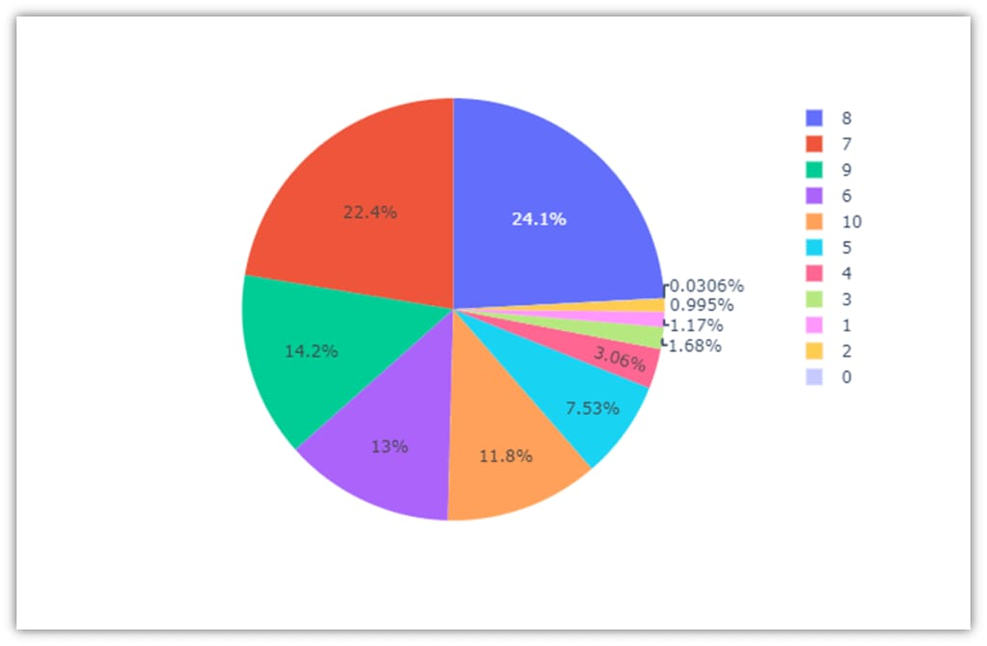
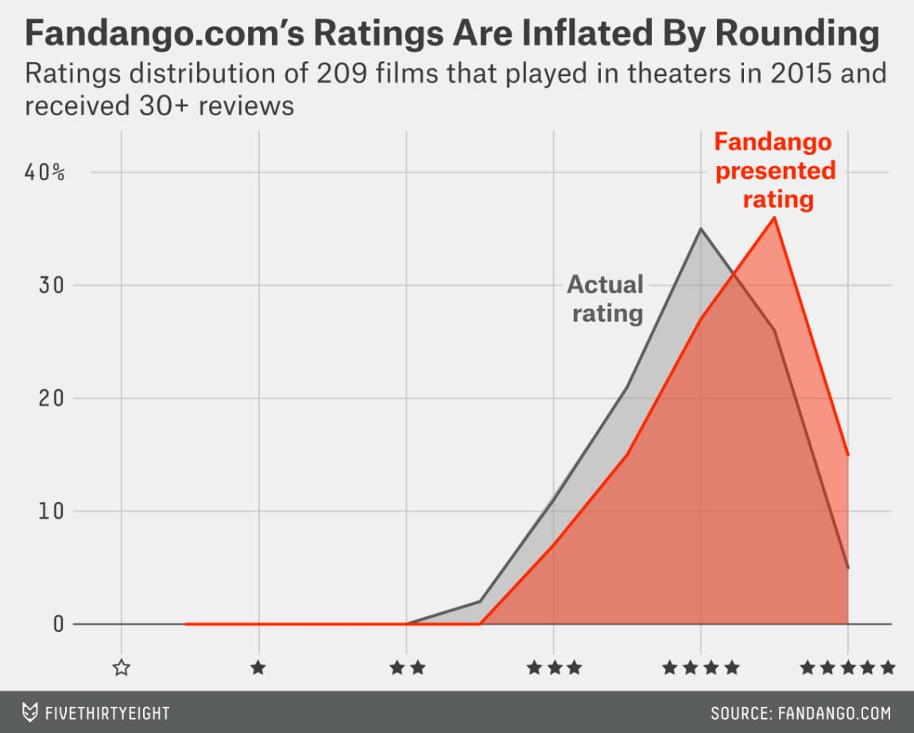
Result

Slide 14
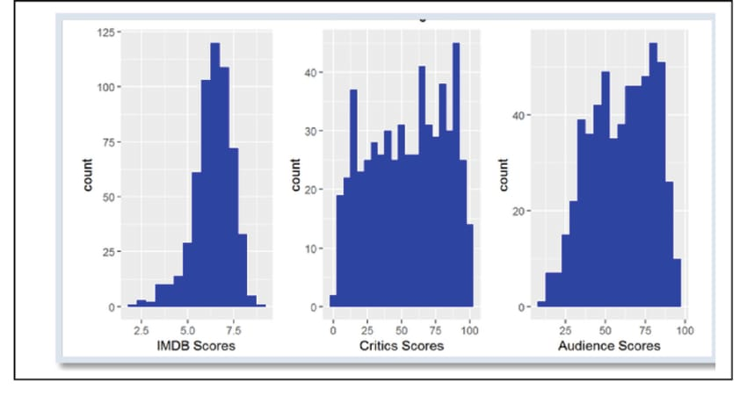
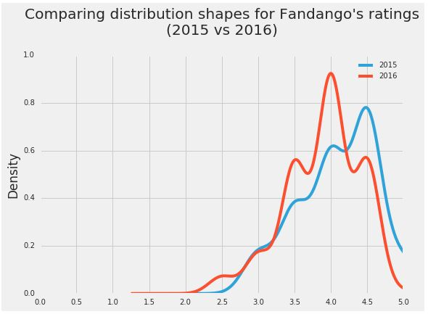
Result

Slide 15
Conclusion
Our analysis showed that there's indeed a slight difference between Fandango's ratings for popular movies in 2015 and Fandango's ratings for popular movies in 2016. We also determined that, on average, popular movies released in 2016 were rated lower on Fandango than popular movies released in 2015.
We cannot be completely sure what caused the change, but the chances are very high that it was caused by Fandango fixing the biased rating system after Hickey's analysis.

Slide 16
Future scope
“Analyzing Fandango movie rating discrepancies using Python has a promising future scope. You could build predictive models to detect inconsistencies, create data visualization tools for insights, or develop automated monitoring systems. Exploring sentiment analysis or machine learning algorithms to understand user reviews could also enhance analysis accuracy. Additionally, integrating with other movie databases for comparative analysis would be beneficial.”

Slide 17
References
https://chat.openal.com
https://www.kaggle.com/datasets
https://pandas.pydata.org/pandasdocs/stable/userguide/index.html
https://seaborn.pydata.org/
https://matplotlib.org/stable/contents.html

Slide 18
THANK YOU

